Slide 1
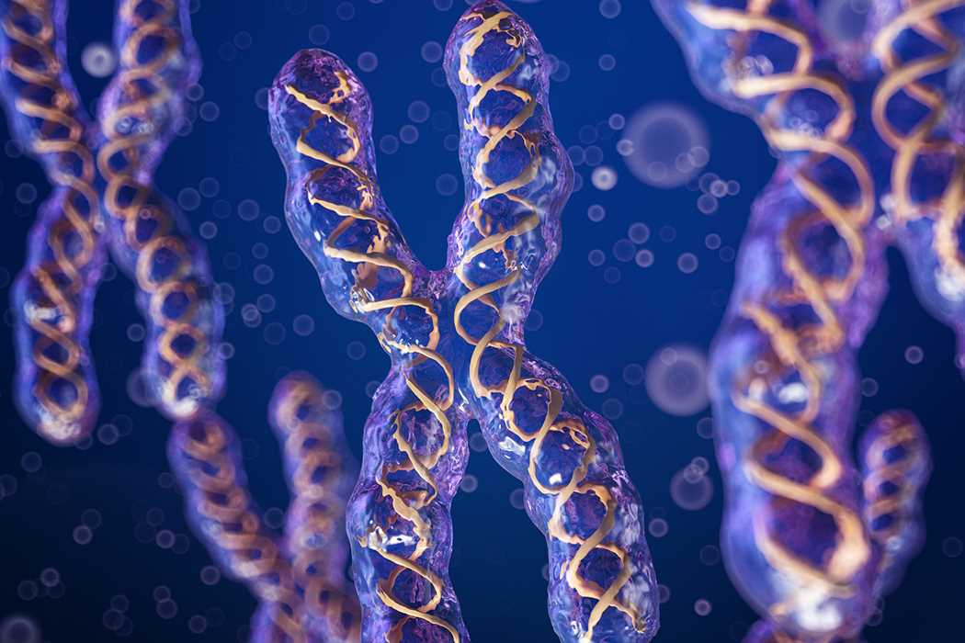
UNIT VII- Chapter 3
Chromosomal Basis of Inheritance

Slide 2
Chapter outline
Chromosomal theory of Inheritance – chromosome behaviour and gene behaviour
Linkage - Eye colour in Drosophila and Seed colour in Maize – complete and incomplete Linkage
Crossing over, Recombination and Gene mapping – Holliday model recombination, three point test cross
Multiple alleles – self sterility in Nicotiana
Sex determination in plants – Sphaerocarpos, papaya and maize
Mutation-types, mutagenic agents and their significance - point mutation types.

Slide 3
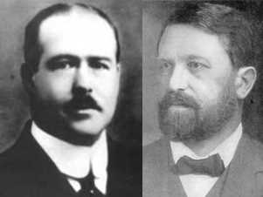
Sutton and Boveri chromosome theory
T. Boveri (1902) - He was responsible for developing the chromosomal theory of inheritance.
W.S. Sutton (1902) - independently recognized a parallelism (similarity) between the behaviour of chromosomes and Mendelian factors.
Sutton and Boveri (1903) - independently proposed the chromosome theory of inheritance. Sutton united the knowledge of chromosomal segregation with Mendelian principles and called it chromosomal theory of inheritance.

Slide 4
Salient features of the Chromosomal theory of inheritance
Somatic cells of organisms consist of two identical sets of chromosomes. One set is received from female and the other from male. In this each two chromosomes constitute homologous pair.
Chromosomes retain their structural uniqueness and individuality throughout the life cycle of an organism.
Each chromosome carries specific determiners or Mendelian factors which are now termed as genes.
The behaviour of chromosomes during the gamete formation (meiosis) provides evidence that genes or factors are located on chromosomes

Slide 5
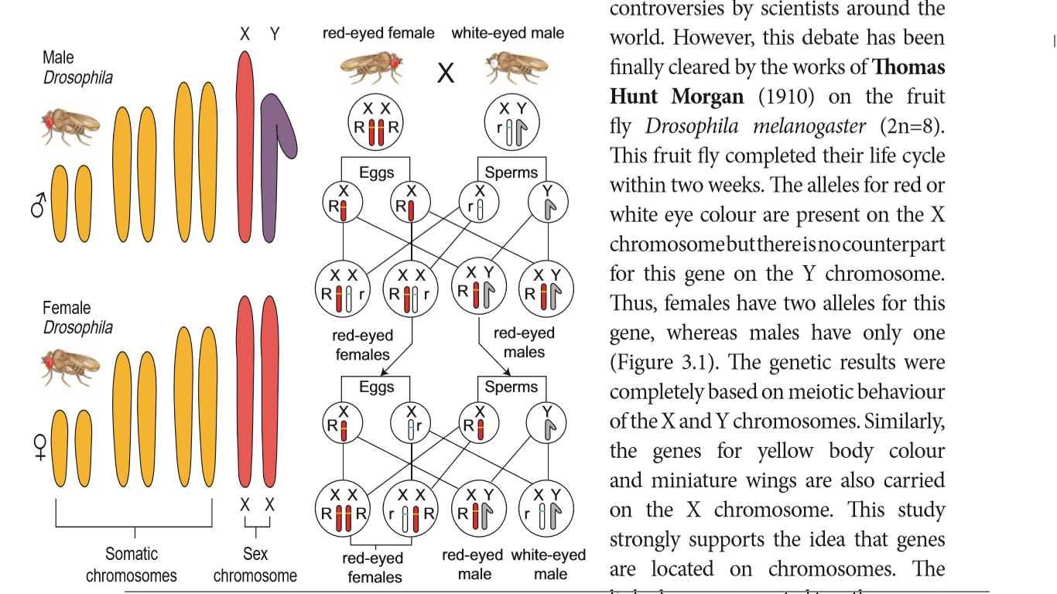
Support for chromosomal theory of heredity
Thomas Hunt Morgan (1910) on the fruit fly Drosophila melanogaster (2n=8).
The gene for red and white eye colour are present on the X chromosome only absent in Y chromosome.
This study support that genes located on chromosomes.
Also an example for sex linkage

Slide 6
Comparison between gene and chromosome behaviour
Comparison of chromosome and gene behaviour

Slide 7
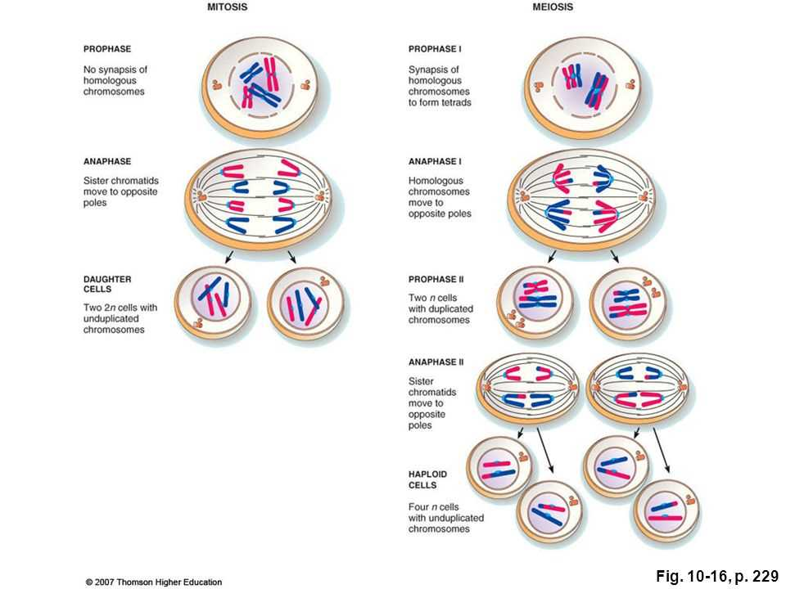
Gene and chromosome behaviour during cell division
The alleles of a genotype are found in the same locus of a homologous chromosome (A/a).
In the S phase of meiotic interphase each chromosome replicates forming two copies of each allele (AA/aa), one on each chromatid.
The homologous chromosomes segregate in anaphase I, thereby separating two different alleles (AA) and (aa).
In anaphase II of meiosis, separation of sister chromatids of homologous chromosomes takes place. Therefore, each daughter cell (gamete) carries only a single allele (gene) of a character (A), (A), (a) and (a).

Slide 8
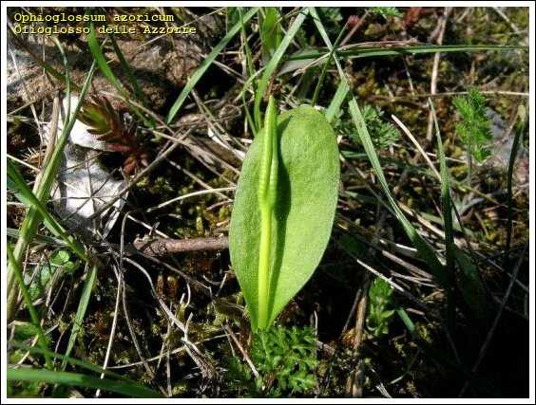
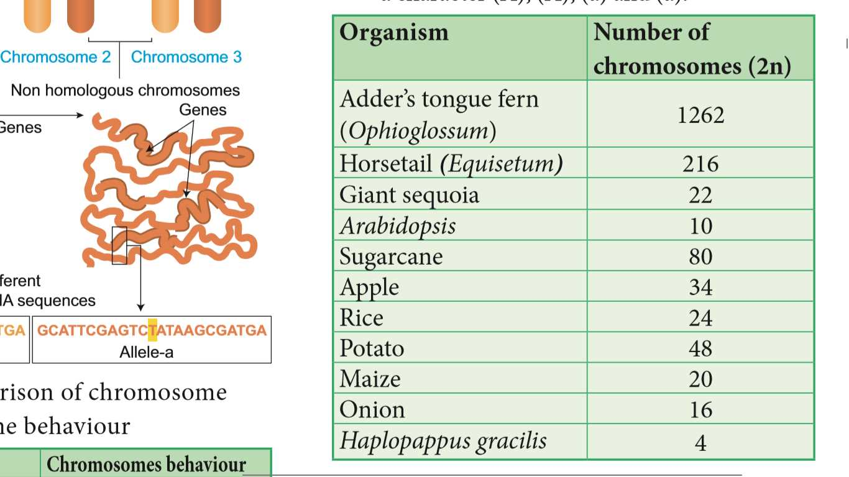
Number of Chromosomes
Ophioglossum

Slide 9
Linkage
It is one of the Mendel’s deviation concept against for law of Independent assortment.
The tendency of genes to stay together during separation of chromosomes is called Linkage. Genes do not independently assort out.
It was reported in Sweet pea (Lathyrus odoratus) by Willium Bateson and Reginald C. Punnet in 1906.
Purple flower long pollen X red flower round pollen
PL/PL pl/pl
F₂ progenies did not exhibit in 1:1:1:1 ratio

Slide 10
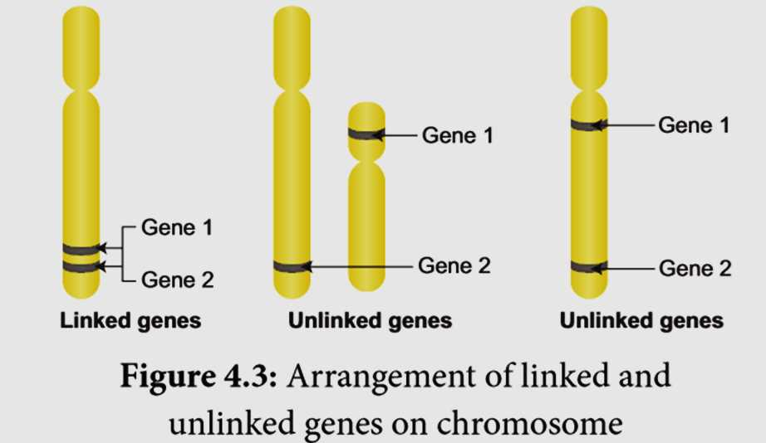
Arrangement of linked and unlinked genes on chromosome
Linked genes – close together
Unlinked genes or syntenic genes – sufficiently far apart
It is differed by recombination frequency value
More than 50% - unlinked genes
Less than 50% -linked genes

Slide 11
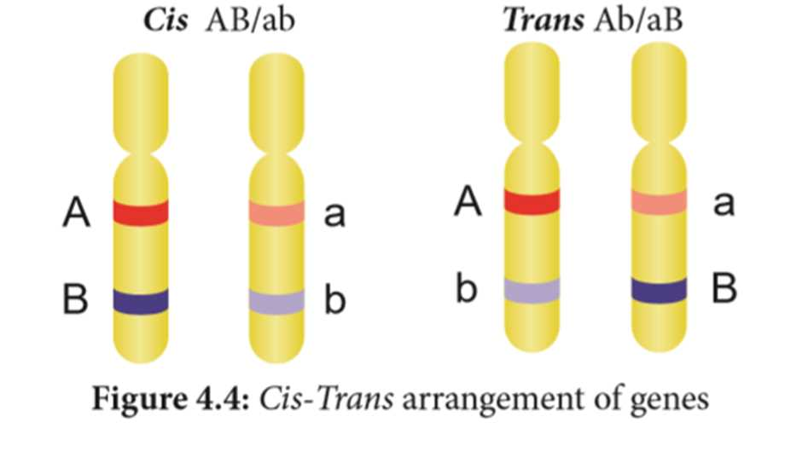
Cis-Trans arrangement of genes
Coupling or Cis configuration
Two dominant or recessive alleles present on same chromosome of homologous , inherit together into same gamete.
Repulsion or Trans configuration
Two dominant or recessive alleles present on different but same homologous chromosome, inherit apart into different gamete.

Slide 13
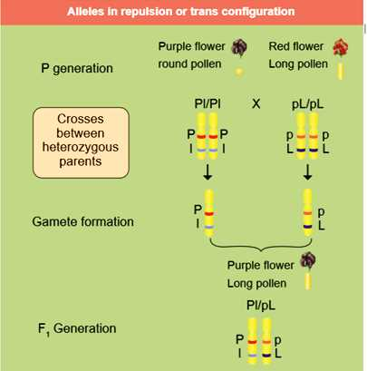
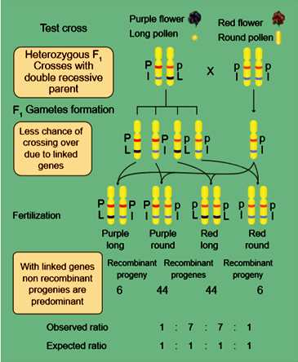

Slide 14
Kinds of linkage
Complete linkage
Incomplete linkage
The genes located very close together and do not exhibit crossing over.
Reported in male Drosophila
C.B Bridges (1919)
The genes located sufficiently apart and exhibit some crossing over.
Reported in maize
Hutchinson
Linkage groups- corresponds to haploid set of chromosomes
Name of organism Linkage groups Mucor 2
Drosophila 4
Sweet pea 7
Neurospora 7
Maize 10

Slide 16
Difference between linkage and crossing over
Linkage | Crossing over
1. The genes present on chromosome stay close together | It leads to separation of linked genes
2. It involves same chromosome of homologous chromosome | It involves exchange of segments between non-sister chromatids of homologous chromosome.
3. It reduces new gene combinations | It increases variability by forming new gene combinations. lead to formation of new organism.

Slide 17
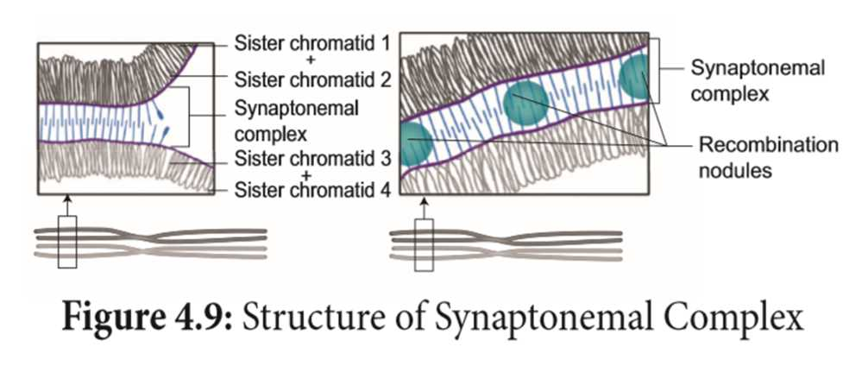
Mechanism of crossing over
Structure of Synaptonemal Complex

Slide 18
Types of Crossing Over
Depending upon the number of chiasmata formed crossing over may be classified into three types.
Single cross over: Formation of single chiasma and involves only two chromatids out of four.
Double cross over: Formation of two chiasmata and involves two or three or all four strands
Multiple cross over: Formation of more than two chiasmata and crossing over frequency is extremely low.

Slide 19
Importance of Crossing Over
Crossing over occurs in all organisms like bacteria, yeast, fungi, higher plants and animals.
Exchange of segments leads to new gene combinations which
plays an important role in evolution.
Studies of crossing over reveal that genes are arranged linearly
on the chromosomes.
Genetic maps are made based on the frequency of crossing over.
Crossing over helps to understand the nature and mechanism of
gene action.
If a useful new combination is formed it can be used in plant breeding.

Slide 20
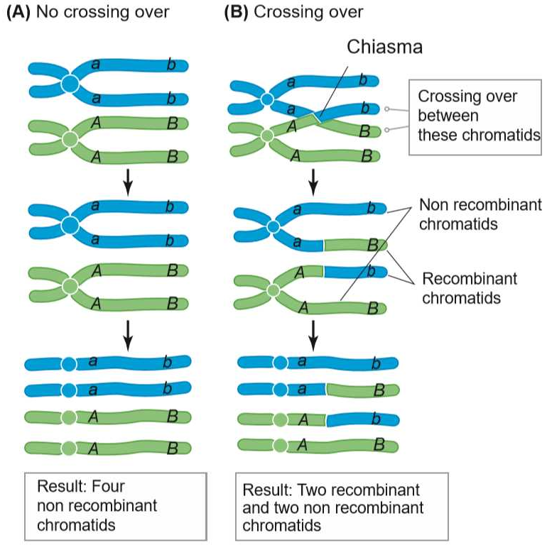
Recombination
Formation of new combination of characters in an organism called Recombinants
This process is called Recombination.

Slide 21
Holliday model showing Recombination
The widely accepted model is Holliday’s hybrid DNA model.
It was first proposed by Robin Holliday(1964)
Homologous DNA molecules are paired side by side with their duplicated copies of DNAs
One strand of both DNAs cut in one place by the enzyme endonuclease.
The cut strands cross and join the homologous strands forming the Holliday structure or Holliday junction.
The Holliday junction migrates away from the original site, a process called branch migration, as a result heteroduplex region is formed.
DNA strands may cut along through the vertical (V) line or horizontal (H) line.
The vertical cut will result in heteroduplexes with recombinants.
The horizontal cut will result in heteroduplex with non recombinants.

Slide 22
RF = Total number of recombinants
Total number of offsprings
= 6+6 x 100
44+6+6+44
= 12 x 100
100
RF = 12%

Slide 23
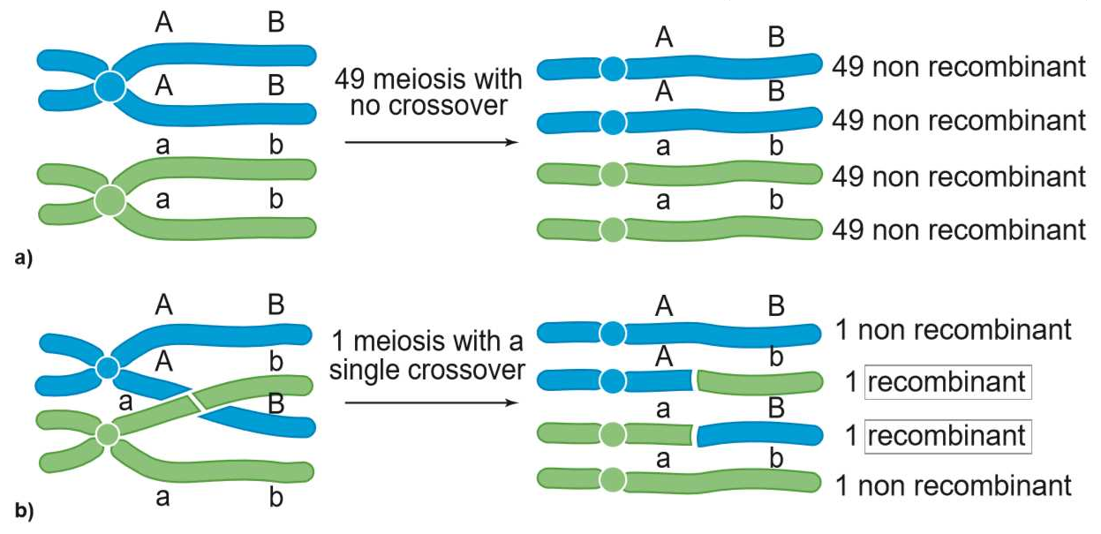
Recombination frequency observation
RF = Number of recombinants x 100
Number of off springs
= 1+1 x 100
49+49+49+49+1+1+1+1
= 2 x 100
200
RF = 1%

Slide 24
Genetic mapping
The diagrammatic representation of position of genes and related distances between the adjacent genes is called genetic mapping.
It is directly proportional to the frequency of recombination between them. It is also called as linkage map.
The concept of gene mapping was first developed by Morgan’s student Alfred H Sturtevant in 1913.
Map distance: The unit of distance in a genetic map is called a map unit (m.u). One map unit is equivalent to one percent of crossing over. One map unit is also called a centimorgan (cM) in honour of T.H. Morgan. 100 centimorgan is equal to one Morgan (M).
Genetic maps can be constructed from a series of test crosses for pairs of genes called two point crosses. But this is not efficient because double cross over is missed.

Slide 25
Three point test cross
A more efficient mapping technique is to construct based on the results of three-point test cross.

Slide 26
Three point test cross
A more efficient mapping technique is to construct based on the results of three-point test cross.
The analysis of a three-point cross

Slide 27
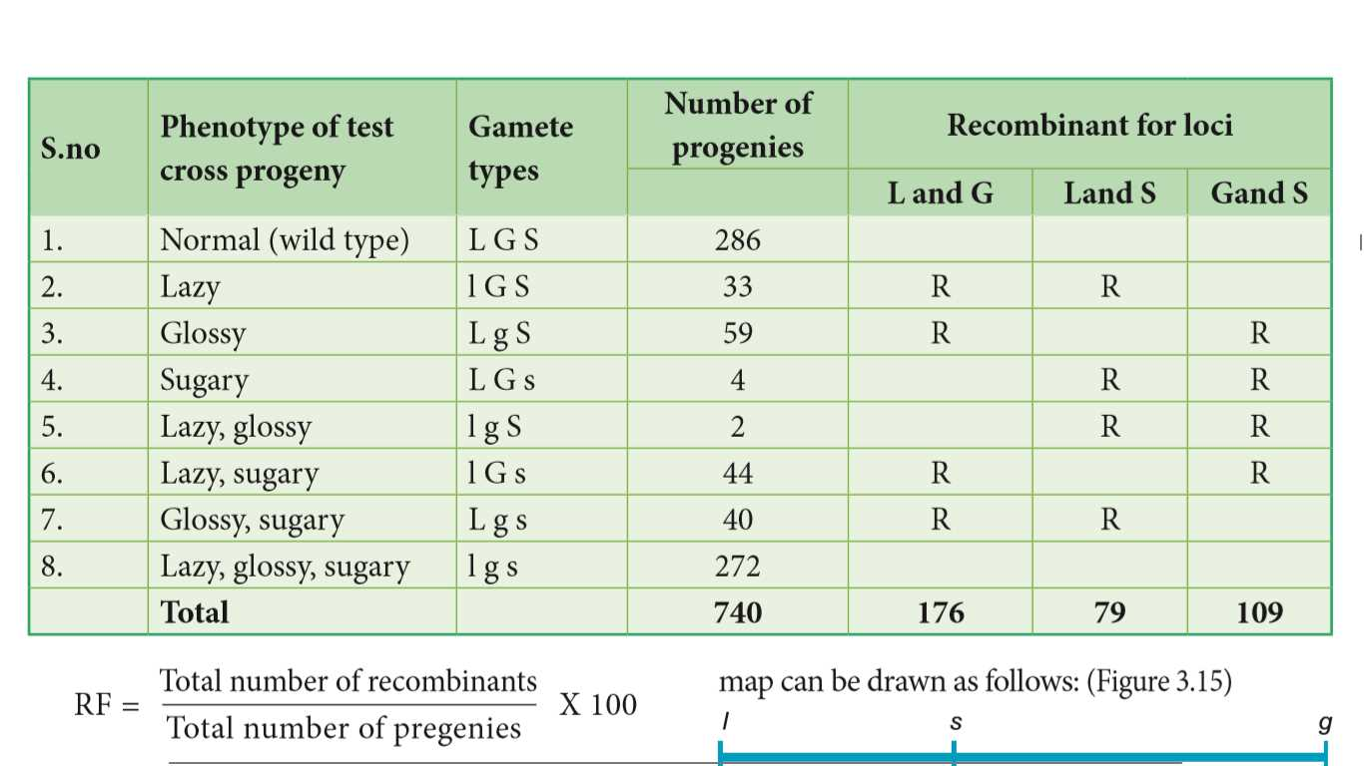

Slide 28
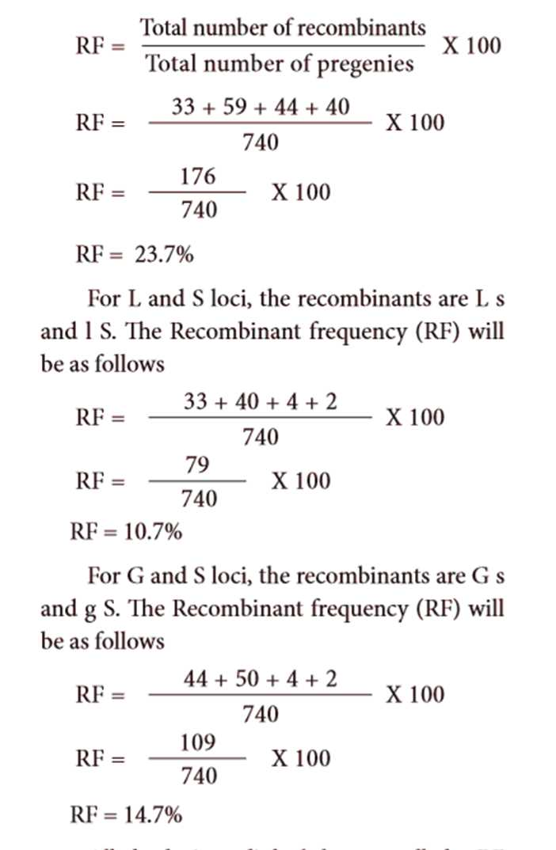
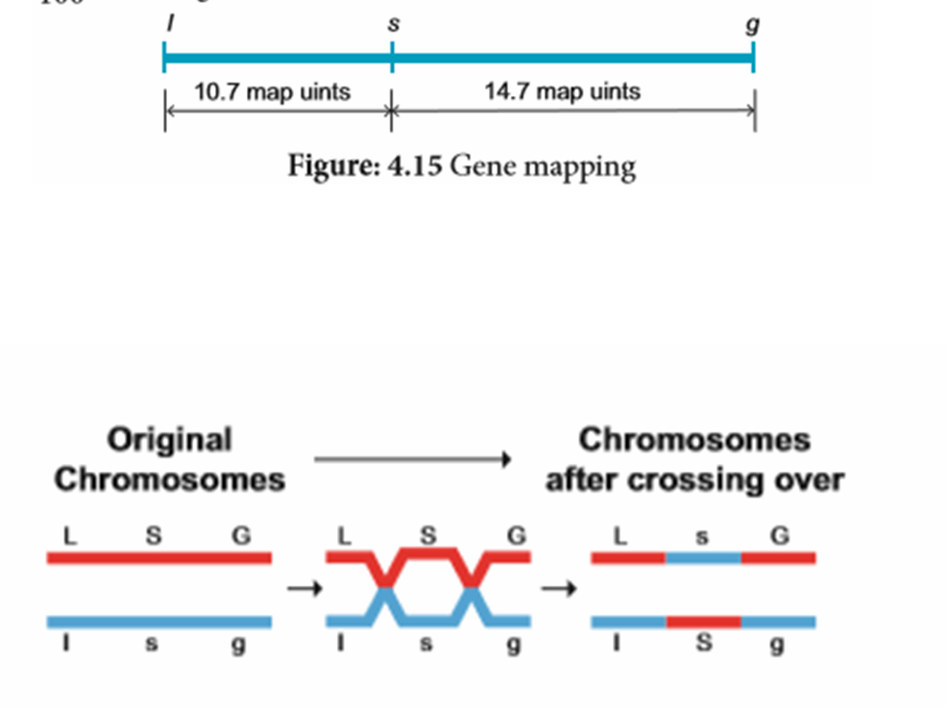
Gene mapping
Gene order showing double recombinant

Slide 29
Uses of genetic mapping
� It is used to determine gene order, identify the locus of a gene and calculate the distances between genes.
� They are useful in predicting results of dihybrid and trihybrid crosses.
� It allows the geneticists to understand the overall genetic complexity of particular

Slide 30
Multiple alleles
Three or more allelic forms of a gene occupy the same locus in a homologous chromosomes called multiple alleles.
Check your Grasp
There may be multiple alleles within the population, but individuals have only two of those alleles. Why?
Characteristics of multiple alleles
• It occupy the same locus in the homologous chromosome, no crossing over occurs within the alleles of a series.
• Multiple alleles are always responsible for the same character.
• The wild type alleles of a series exhibit dominant character whereas mutant type will influence dominance or an intermediate phenotypic effect.
• When any two of the mutant multiple alleles are crossed the phenotype is always mutant type and not the wild type

Slide 31
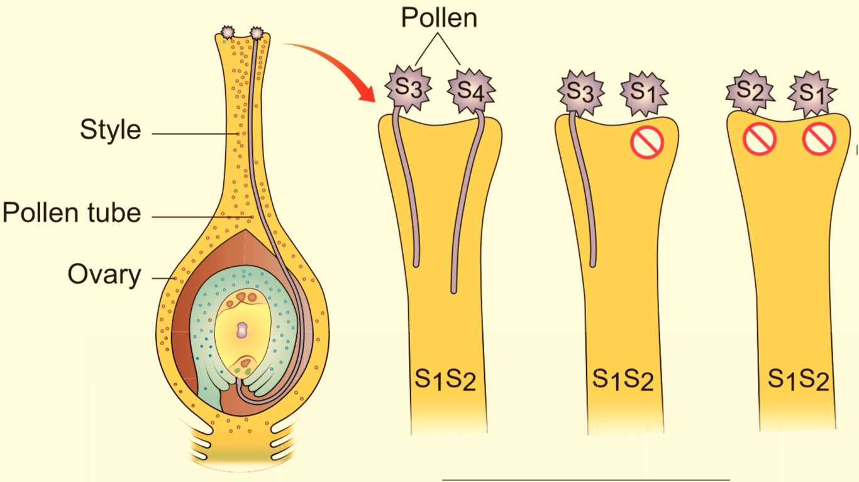
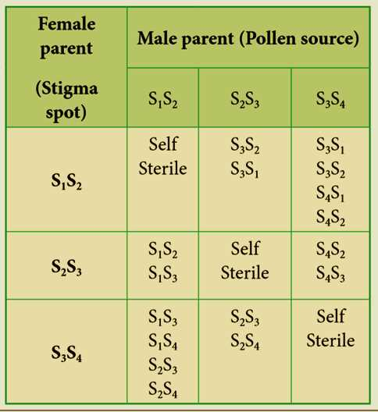
Self-sterility in Nicotiana
East (1925) observed multiple alleles in Nicotiana which are responsible for self-incompatibility or self-sterility.

Slide 32
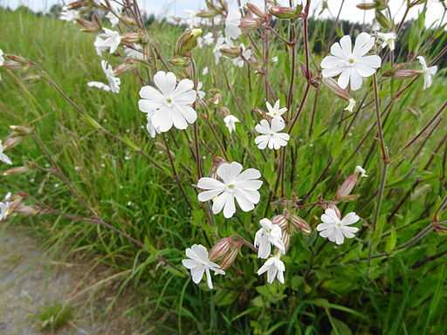
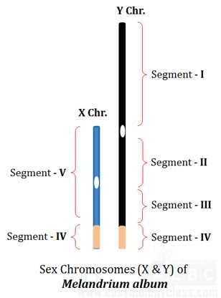
Sex determination in plants
C.E. Allen (1917).
It is a complex process determined by genes, the environment and hormones.
About 94% of all flowering plants sexually monomorphic.
Some 6% of flowering plants dimorphic.
Sex determination in Silene latifolia (Melandrium album)
Y chromosome determines maleness
X specifies femaleness
X and Y show different segments

Slide 33
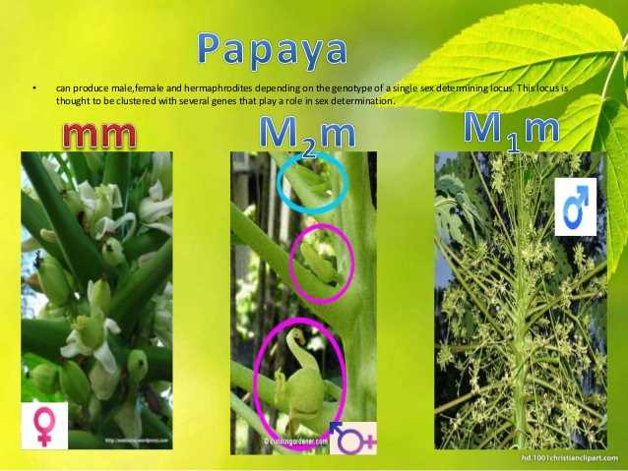
Sex determination in Papaya
Sex determination in papaya Recently researchers in Hawaii discovered sex chromosomes in Papaya (Carica papaya, 2n=36).

Slide 34
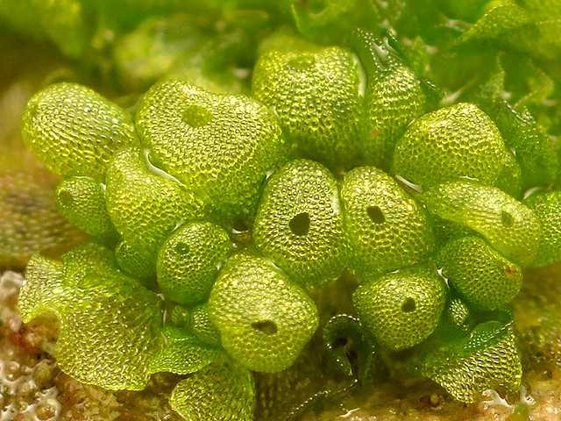
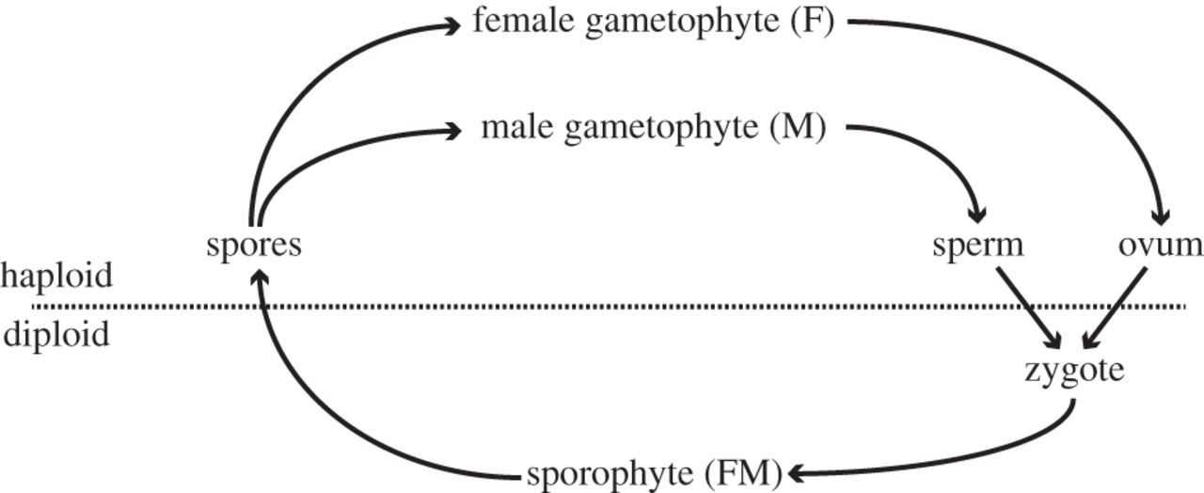
Sex Determination in Sphaerocarpos
First described among bryophytes
Sphaerocarpos donnellii which has heteromorphic chromosomes.
The male gametophyte as well as the female gametophyte is an haploid organism with 8 chromosome (n=8).
The diploid sporophyte is always heterogametic.

Slide 35
Sex determination in Maize
(Superscript (+) denotes dominant character)
Sex determination in maize
Zea mays (maize) is an example for monoecious
Two types of inflorescence.
Tassel- staminate florets
Ear- pistillate florets

Slide 36
Mutation
Hugo de Vries (1901)
He has studying on the plant, evening primrose (Oenothera lamarkiana) and proposed ‘Mutation theory’.
Two broad types of mutation
Point mutation
Chromosomal mutations
Mutagens or mutagenic agents
Mutagenesis
The production of mutants through exposure of mutagens.
The organism is said to be mutagenized.

Slide 37
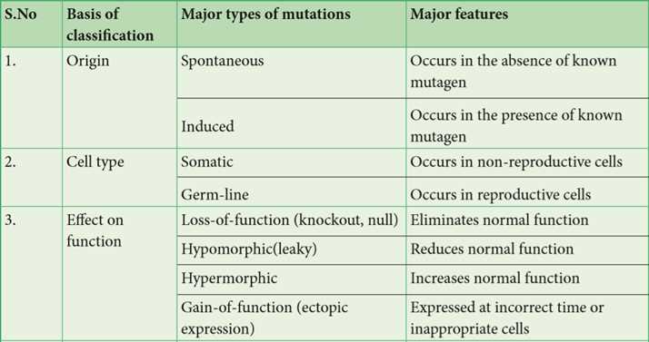

Slide 38
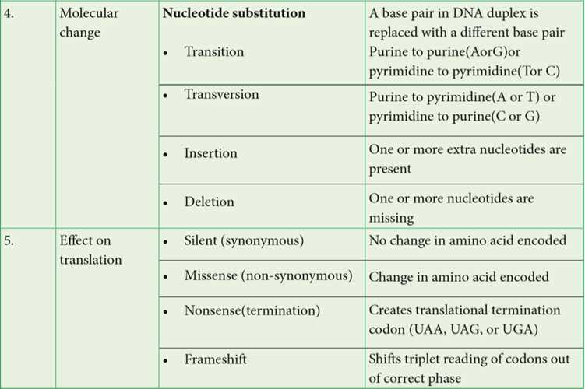

Slide 39
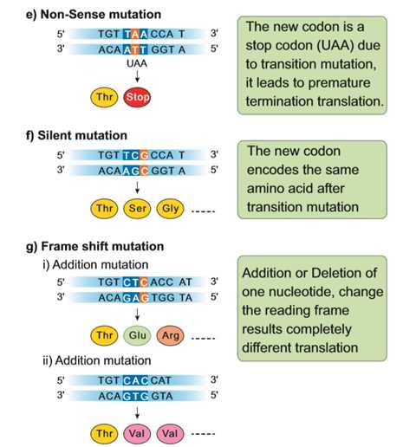

Slide 40
Mutagenic agents
Muller (1927) was the first to find out physical mutagen in Drosophila.
Physical mutagens:
Temperature, Radiation
Sharbati Sonora
Castor Aruna
Chemical mutagens
Mustard gas, nitrous acid,
ethyl and methyl methane sulphonate (EMS and MMS), ethyl urethane, magnous salt,
formaldehyde, eosin and enthrosine
Comutagens
The compounds which are not having own mutagenic properties but can enhance the effects of known mutagens are called comutagens. Example: Ascorbic acid increase the damage caused by hydrogen peroxide.

Slide 41
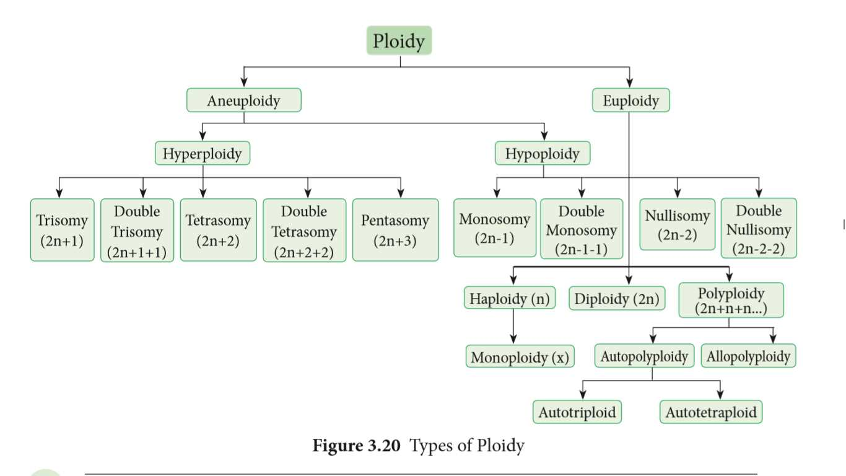
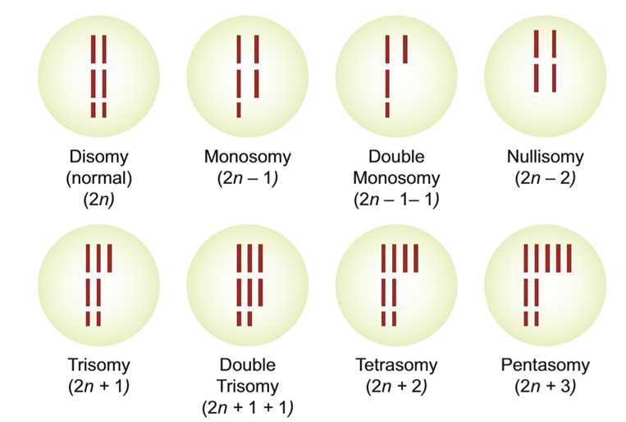
Changes in chromosome number

Slide 42
Allopolyploidy
Two or more basic sets of chromosomes derived from two different species is called allopolyploidy.
Allopolyploids are formed between closely related species only.
Example: Raphanobrassica
G.D. Karpechenko (1927) a Russian geneticist, crossed the radish (Raphanus sativus, 2n=18) and cabbage (Brassica oleracea, 2n=18) to produce F₁ hybrid which was sterile.

Slide 43
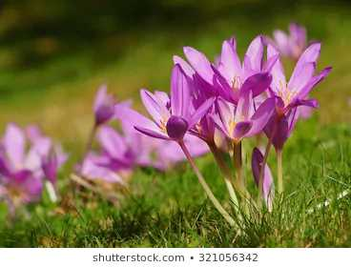
Triticale, the successful first man made cereal.
Tetraploidy: Crosses between diploid
wheat and rye.
(ii) Hexaploidy: Crosses between tetraploid wheat and rye.
(iii) Octoploidy: Crosses between hexaploid wheat and rye.
Colchicine, an alkaloid extracted from Colchicum autumnale

Slide 44
Activity: Solve this
When two plants (A and B) belonging to the same genus but different species are crossed, the F1 hybrid is viable and has more ornate flowers. Unfortunately, this hybrid is sterile and can only be propagated by vegetative cuttings. Explain the sterility of the hybrid and what would have to occur for the sterility of this hybrid to be reversed.

Slide 45
Significance of Ploidy
• Many polyploids are more vigorous and more adaptable than diploids.
• Many ornamental plants are autotetraploids and have larger flower and longer
flowering duration than diploids.
• Autopolyploids usually have increase in fresh weight due to more water content.
• Aneuploids are useful to determine the phenotypic effects of loss or gain of
different chromosomes.
• Many angiosperms are allopolyploids and they play a role in an evolution of
plants.

Slide 46
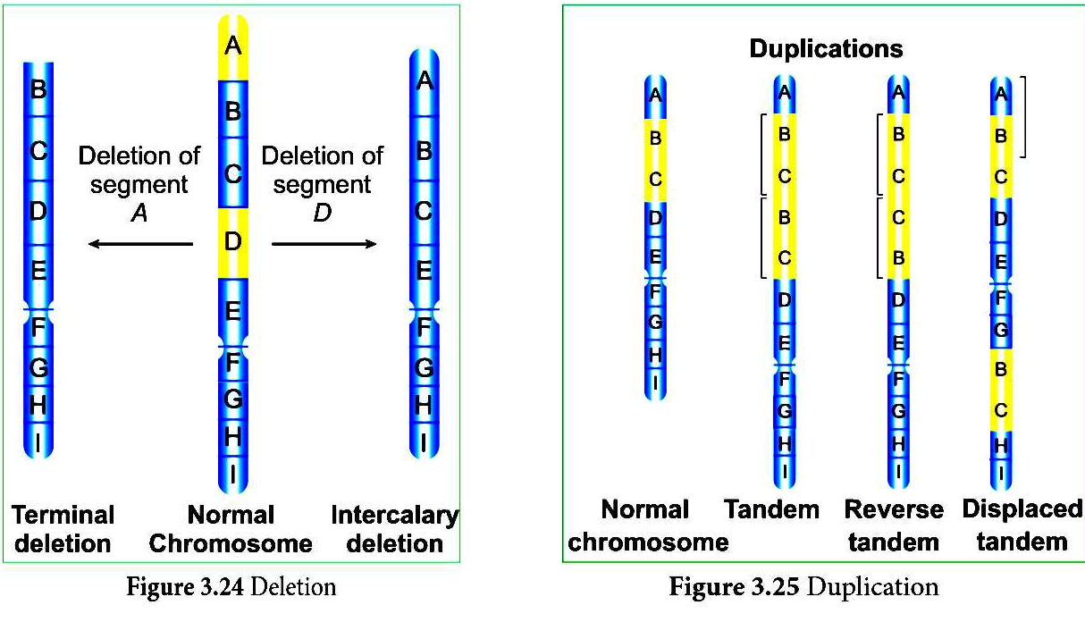
Structural changes in chromosome (Structural chromosomal aberration)

Slide 47
Inversion
Translocation

Slide 48
